Slide 1
Welcome to: MiU!
Week 1

Slide 2
Contact Information
Email: rgroffalarcon@fullsail.com
iChat: rgroffalarcon@aim.com
Text: 407-900-9648 (9MiU) – IF I am not on during office hours. I will block this number is if it is abused. (Please be sure that you identify yourself as all I see is a phone #.)
Office Phone Number: 407-679-0100 x4151

Slide 3

Author: Jenifer Tidwell Publisher: O'Reilly 2nd Edition (2011)

Slide 4
FSO Support
If you have not received your textbook, please contact FSO support.
Please also contact FSO Support for ANY computer issues that you may encounter. They will either be able to assist you at that time, or provide a ticket number that you can forward to me so that we can work out suitable arrangements.
FSO Support is available from 8AM – 2AM ET.

Slide 5
Completion of Assignments
If at ANY time you feel that you will not be able to meet a deadline, be proactive! Contact me!
It allows us to work together for your benefit.
It prevents me from calling you when you know what needs to be accomplished.

Slide 6
Reactions to MiU
I didn’t start on time, so I ran out of time.
I don’t (or didn’t) get what I was supposed to do.
I’m making everything too difficult.
I got so hung up on other things that I didn’t complete the required portions of the assignment.
Advice: Don’t over think it!

Slide 7
Helpful Hints for MiU
Join FSO MDVBS (Full Sail University) http://www.facebook.com/groups/130832227017920/> http://www.facebook.com/groups/130832227017920/
Have a coding buddy.
Do not wait until Wednesday to start, there is a meaningful commit due EVERY Sunday.
Do NOT wait until the Thursday review video to inform me that you are having trouble.

Slide 8
Helpful Hints for MiU
Use http://wddbs.com/jshero/ first.
Console log your code.
Comment your code.
Pay attention.
In an attempt to improve the course, there is a quick questionnaire related to time, please be sure to answer each one.

Slide 9
Helpful Hints for MiU
MIU is a usability and interfaces course.
That being said, I will not be teaching js.
Please be sure that your VFW CRUD is functioning completely. If you need a review all of the VFW videos are located in the Announcements section.
You WILL have to put in research time.

Slide 10
Do 3 BEFORE Me!
Something that a developer must learn to do is to troubleshoot and problem solve. For this reason, MIU has a “Do 3 BEFORE Me” policy. Simply stated before you contact me, you need to do at least 3 of the following things:
Run your JavaScript through JS Hero, making the necessary corrections. Continue this process until JS Hero shows no errors; take a screenshot showing that there are no errors.

Slide 11
Do 3 BEFORE Me!
Correct the errors that are being shown in the Console, take a screenshot that shows they are cleared.
Check the VFW videos, located in the Announcements section on the Dashboard.
Consult the documentation (jQuery Mobile, HTML, CSS, forums, etc.)
Have your coding buddy look at it.
Make a short video that explains what is wrong and what you have done to try to resolve it.

Slide 12
Questions before we move into the content?
?

Slide 13
What MUST be completed ASAP?
Create a “gh-pages” branch on your GIT repository. Use Terminal, or any other client of your choosing. There is a SmartGit and Git Hub video activity located on the Dashboard.
Naming convention: Lastname_firstname_project X (Where X is the week).

Slide 14
What MUST be completed ASAP? (cont.)
Download the iOS simulator.
Add 20 Dummy Data (JSON) for your application in JavaScript. Remember, you need to create a separate JSON.js file.
Comment your code.

Slide 15
What MUST be completed ASAP? (cont.)
Run your code through:
HTML Beautifier:
http://www.digitalcoding.com/tools/html-beautifier.html
JS Beautifier:
http://jsbeautifier.org/
Online Code Beautifier:
http://ctrlq.org/beautifier/

Slide 16
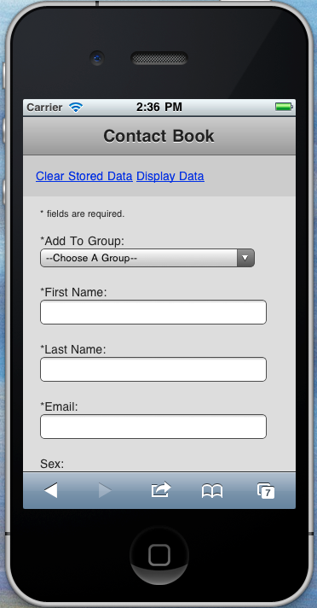
Does this look familiar?
If Chad told you that you needed to fix anything with your week 4 project, you will need to have that fixed for your week 1 project.

Slide 17
What comes to mind when I say “Mobile Interfaces and Usability?”

Slide 18
Mobile
Interactive
Small viewing area
Microbreaks
Ease of Use
Appealing

Slide 19
User Behavior Patterns (pgs 8 – 15)
Safe Exploration
Instant Gratification
Satisficing
Changes in Midstream
Deferred Choices
Incremental Construction
Habituation

Slide 20
User Behavior Patterns (pgs 16 – 23)
Microbreaks
Spatial Memory
Prospective Memory
Streamlined Repetition
Keyboard Only
Other People’s Advice
Personal Recommendations

Slide 22
Warning…
Do NOT add too much custom CSS. When you add JQM next week, it WILL break!
JQM is not introduced until Week 2; however, I would recommend that you go ahead and look at it. If you start with JQM, it will be much easier to continue, but it is your call.

Slide 23
Warning…
The $ is a reserved symbol in jQuery. JQM, which we will be using beginning next week is a jQuery library.
Use Find and Replace to change all of your $(x) with an alpha. For example:
$(getElement) should become ge(getElement).
If you DO NOT do this, JQM WILL BREAK EVERYTHING!!!!!!!!!!!

Slide 24
Warning…
Do NOT wait until the last minute to begin working on your projects. I do not have office hours on Thursdays; however, IF we have been working together throughout the week, feel free to contact me and I will get back to you as soon as I can.
DISCLAIMER: I often have meetings on Thursday, so I cannot say how long it will take for me to reply.

Slide 25
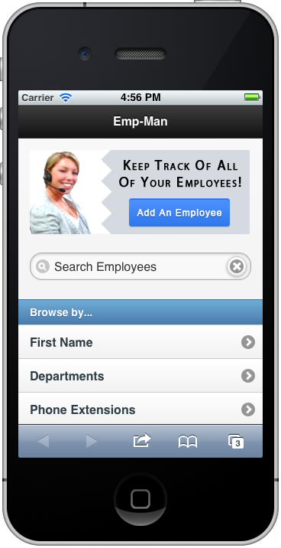
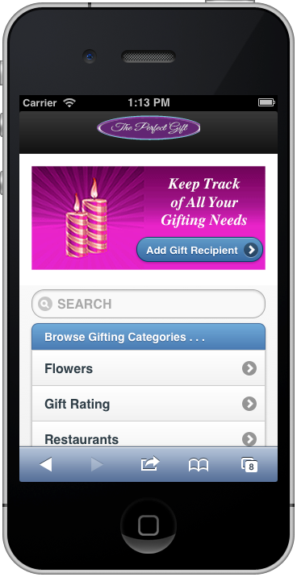
Feature, Search, Browse (pgs 30 – 31)
Search does NOT have to work this week!
Notes:
Matt Toft

Slide 26
Feature Includes:
CTA
Short description
Appealing visual
Feature does not take up a lot of room! Think logo! *Remember what you learned in MMD 2!

Slide 27
Center Stage (pgs 145 – 146)
Draw the user’s focus to the center of the app.
Notes:
Shana Cote

Slide 28
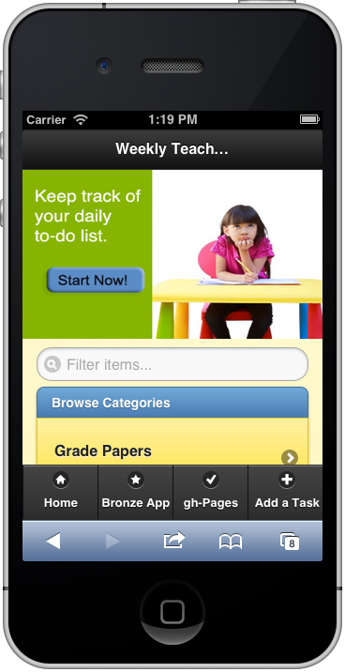
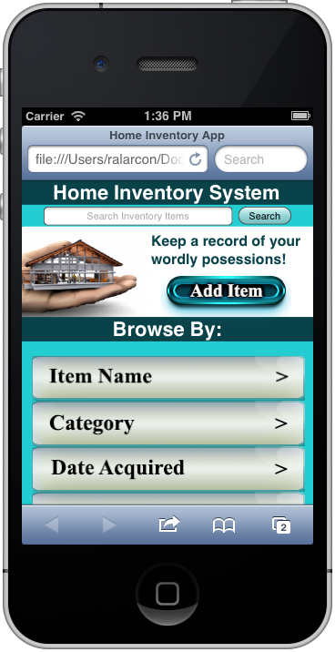
Search:
should be at the top of the app, either just above the Feature or just below it.
does NOT have to work this week!
Notes:
Matt Toft

Slide 29
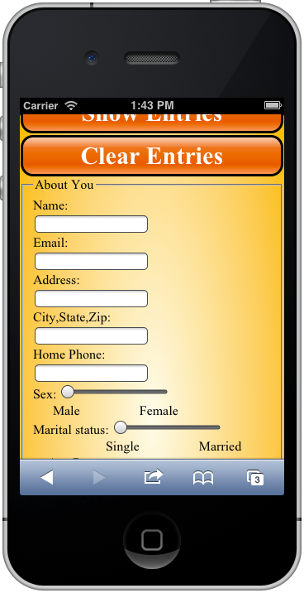
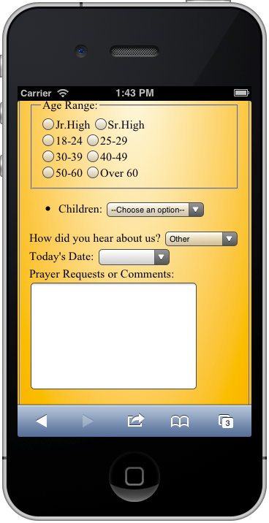
Browse
What Browse sections could be developed from this app?
Notes:
Shana Cote

Slide 30
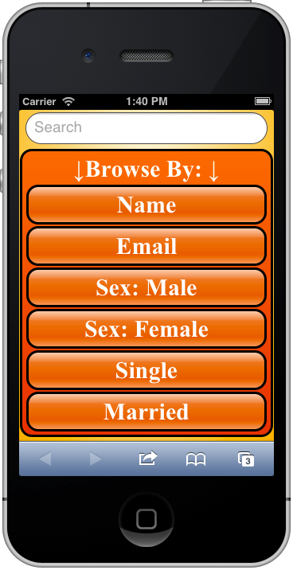
Browse
How did you do?
Were there any others that could have been used?
Notes:
Shana Cote

Slide 31
Titled Sections (pgs 152 – 155)
Notes:
Matt Toft

Slide 32
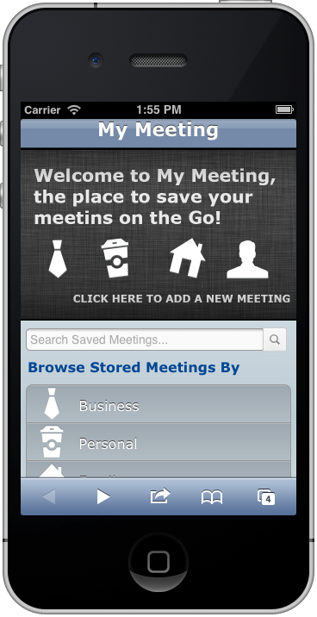
Clear Entry Points (pgs 87 – 88)
Be sure that the user is not confused about where to go to complete a task.
Notes:
Shae Klusman

Slide 33
Professionalism
Your Professionalism grade will include:
Your attitude and language in discussion posts and videos.
Your attitude and language in communication with your fellow students and with me.
You will receive ONE warning and then points will be deducted.
The timeliness of your assignments –25% for each late assignment.

Slide 34
Professionalism (cont.)
The completion of assignments – 25% for each missing assignment.
GoToTraining participation, either live or within 48 hours – 20% for each missed session. You MUST complete the proof of participation to receive credit!
Mini assignments:
Sunday Meaningful commit
Lynda.com screenshot
Your personal investment in your work.

Slide 35
GoToTraining Sessions
When you register, you should download the materials that are there; they will be prior month’s, but the overall information will be the same.
Be sure that you download the material for the current month sometime during the session.
Be sure you have gone over the material so that you can ask questions.

Slide 36
GoToTraining Sessions
Do not wait until the GTT to begin working on the work for the week.
Keep the conversation on topic. When the session is over, we will have a “gloves off” session in which you can deviate.
Be sure that you submit the “Mini assignment” so that you will receive credit for participation. Simply being in the session is not enough.

Slide 38
Reflection Videos
Project will NOT be graded if the video is not submitted.
Your links must be live and/or embedded.
You must answer ALL of the questions. It is helpful if you state the question prior to answering it.
Provide a justification for ALL of your choices.
Video may be 3 – 5 minutes.

Slide 40
Discussion Videos – All weeks
Your video is due on Friday night.
Please be sure that you answer all of the questions.
Week 4 is a research topic, so please be sure that you do not wait until the last minute.
Discussion videos are all or nothing!

Slide 42
Discussion Responses – All Weeks
Your response is due on Saturday night.
2 text responses to your classmates are due on Saturday night. This is also all or nothing.
Please address the person to whom you are responding my name. (ie: Johnny, I love Angry Birds too. Those pigs are so annoying!) This allows me to understand to whom you are commenting. Often, I will not yet have seen the video as I grade your responses.

Slide 44
?

Slide 45
Xcode installation
To install xCode:
Click on Launchpad,
Launch xCode,
Choose Preferences,
Go to downloads,
Choose the newest iOS Simulator and click install.

Slide 46
To place the Sim on the dock
Launch xCode,
Open Developer Tools,
iOS Simulator,
Right click Sim icon in dock,
Options,
Keep in Dock

Slide 47
Finding iOS sim – long way
To trace the iOS sim, go to:
Applications,
xCode,
Contents,
Developer,
Platforms,
iPhoneSilmulator.platform,
Developer,
Applications,
iOS simulator.

Slide 48
Using iOS Sim
To use the iOS file that you just located:
drag it down to the dock, this will keep it on your dock for ease of use later.
To use the Sim:
Open the Sim,
simply drag your html file into it.

Slide 49
GoToTraining verification Mini Assignment – due by 11:59 PM ET Wednesday
Please send an email to me that contains:
Your name, along with your preferred name. (This should be the name you are using in Google Groups.)
Your iChat handle, including the host. ie: rgroffalarcon@aim.com
The time of day that you are most likely to be on iChat for assistance – be sure you state the time zone.
Your Google+ account name.

Slide 50
FSO Announcements:
Please be sure that you read:
MDVBS Late Work Policy.
MDVBS Interactive Support Policy.
MDVBS Academic Integrity Policy.
Facebook group link.
Helpful links, etc.

Slide 51
Contact Information
Email: rgroffalarcon@fullsail.com
iChat: rgroffalarcon@aim.com
Text: 407-900-9648 (9MiU) – IF I am not on during office hours. I will block this number is if it is abused.
Office Phone Number: 407-679-0100 x4151

